Slide 1


Swept-Source Anatomic Optical Coherence Tomography for Airway Imaging
Ruofei Bu
Group Meeting Sep. 21st
Notes:
I represent our team to introduce the anatomic OCT system for the elastography study of the pig trachea.

Slide 2
Content
Motivation
aOCT system and setup
Morphology
Pullback scan
Stationary scan
Discussion

Slide 3
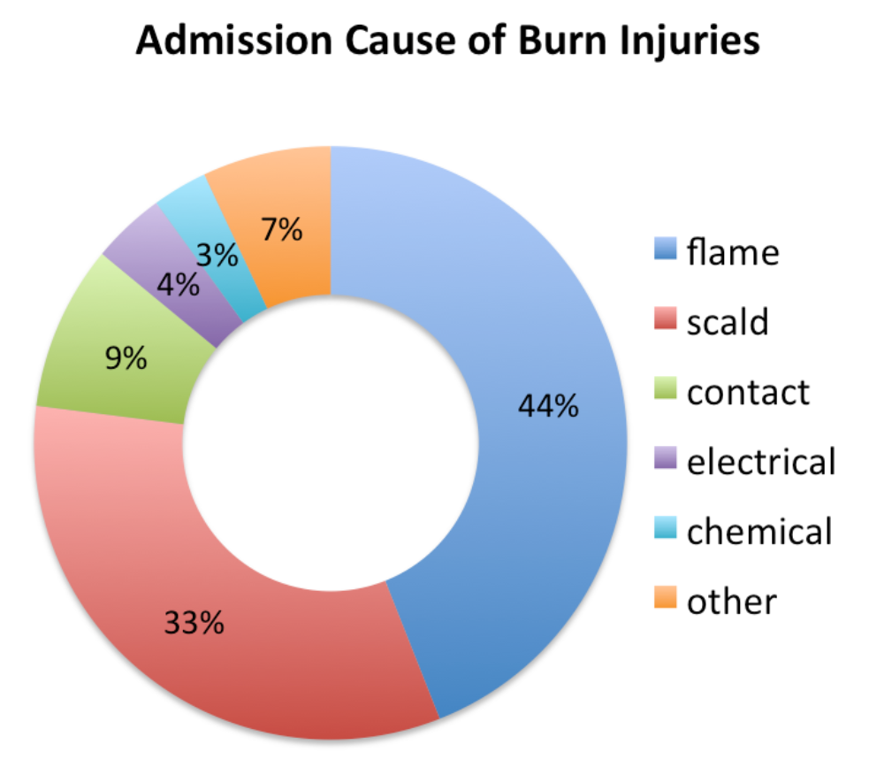
Motivation
Burn injuries
More than 420,000 burn injuries in the US
Inhalation injuries in 10% to 35%
Previous diagnosis
Bronchoscopy and Xenon lung scans
Fiberoptic bronchoscopy and histology findings -- gold-standard
Petersburg Office, Burn Injury Lawyers in Richmond and Petersburg, Virginia,
Notes:
Upper airway obs diso is a common problem, which includes differnts kinds of diseases like OSA and SGS in children. Imaging of upper airway obstructions in children and adults is needed to improve clinical decision-making. Endos, However, CT, MRI. OCT technique is an attractive alternative as they are well-suited for providing minimum-invasive, microscopic resolution imaging of light scattering structures. In our study, we not only use OCT to capture quantitative CSA imaging, but also use it to pinpoint dynamic collapse in OSA, and meanure elasticty
up to 5% of adults in Western countries are likely to have undiagnosed OSA syndrome

Slide 4
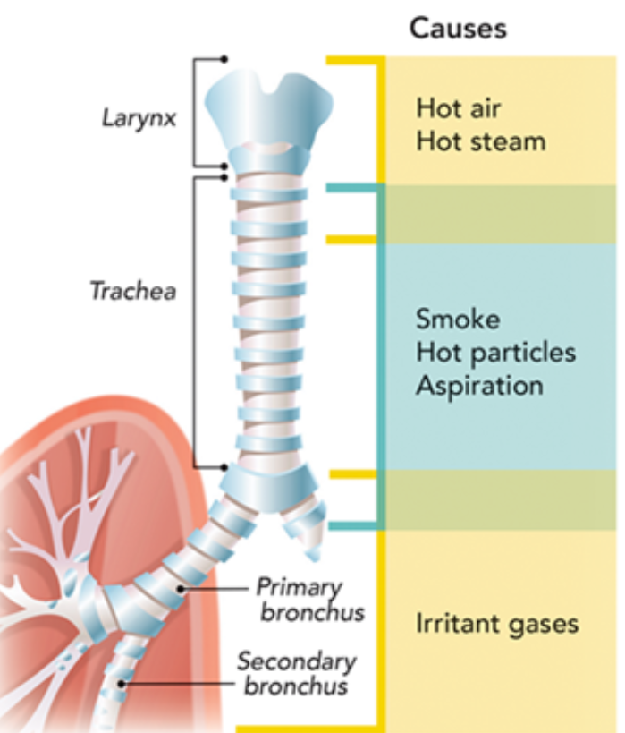
Motivation
Inhalation injuries
Edema,
Swelling,
Increased microvascular permeability
Loss of ciliary action
Airway occlusion
Inhalation injuries characterization
Anatomic location of the injury
Mechanism of injury
Edward A. Bittner, et al, Anesthesiology 2, Vol.122, 448-464: (2015)
Notes:
Upper airway obs diso is a common problem, which includes differnts kinds of diseases like OSA and SGS in children. Imaging of upper airway obstructions in children and adults is needed to improve clinical decision-making. Endos, However, CT, MRI. OCT technique is an attractive alternative as they are well-suited for providing minimum-invasive, microscopic resolution imaging of light scattering structures. In our study, we not only use OCT to capture quantitative CSA imaging, but also use it to pinpoint dynamic collapse in OSA, and meanure elasticty
up to 5% of adults in Western countries are likely to have undiagnosed OSA syndrome

Slide 5
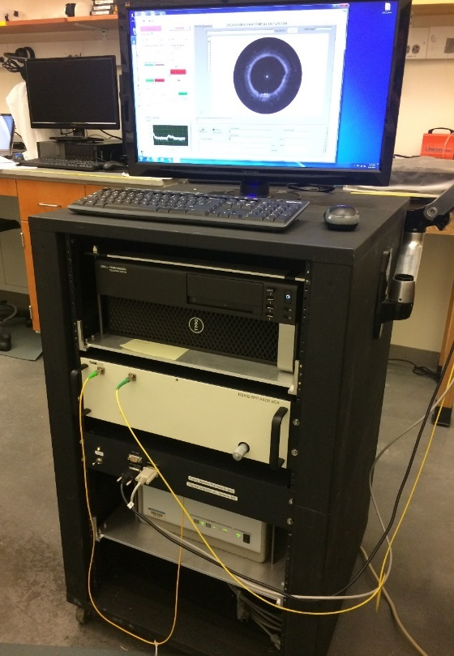
aOCT scan setup
System | Thorlabs
Center wavelength (nm) | 1300
Sweep range (nm) | ~100
Coherence length (mm) | >50
A-line rate (Hz) | 100k
K-clock required | Yes
Sampling rate (Ms/s) | 235-540
Axial resolution (µm) | 10.6

Slide 6
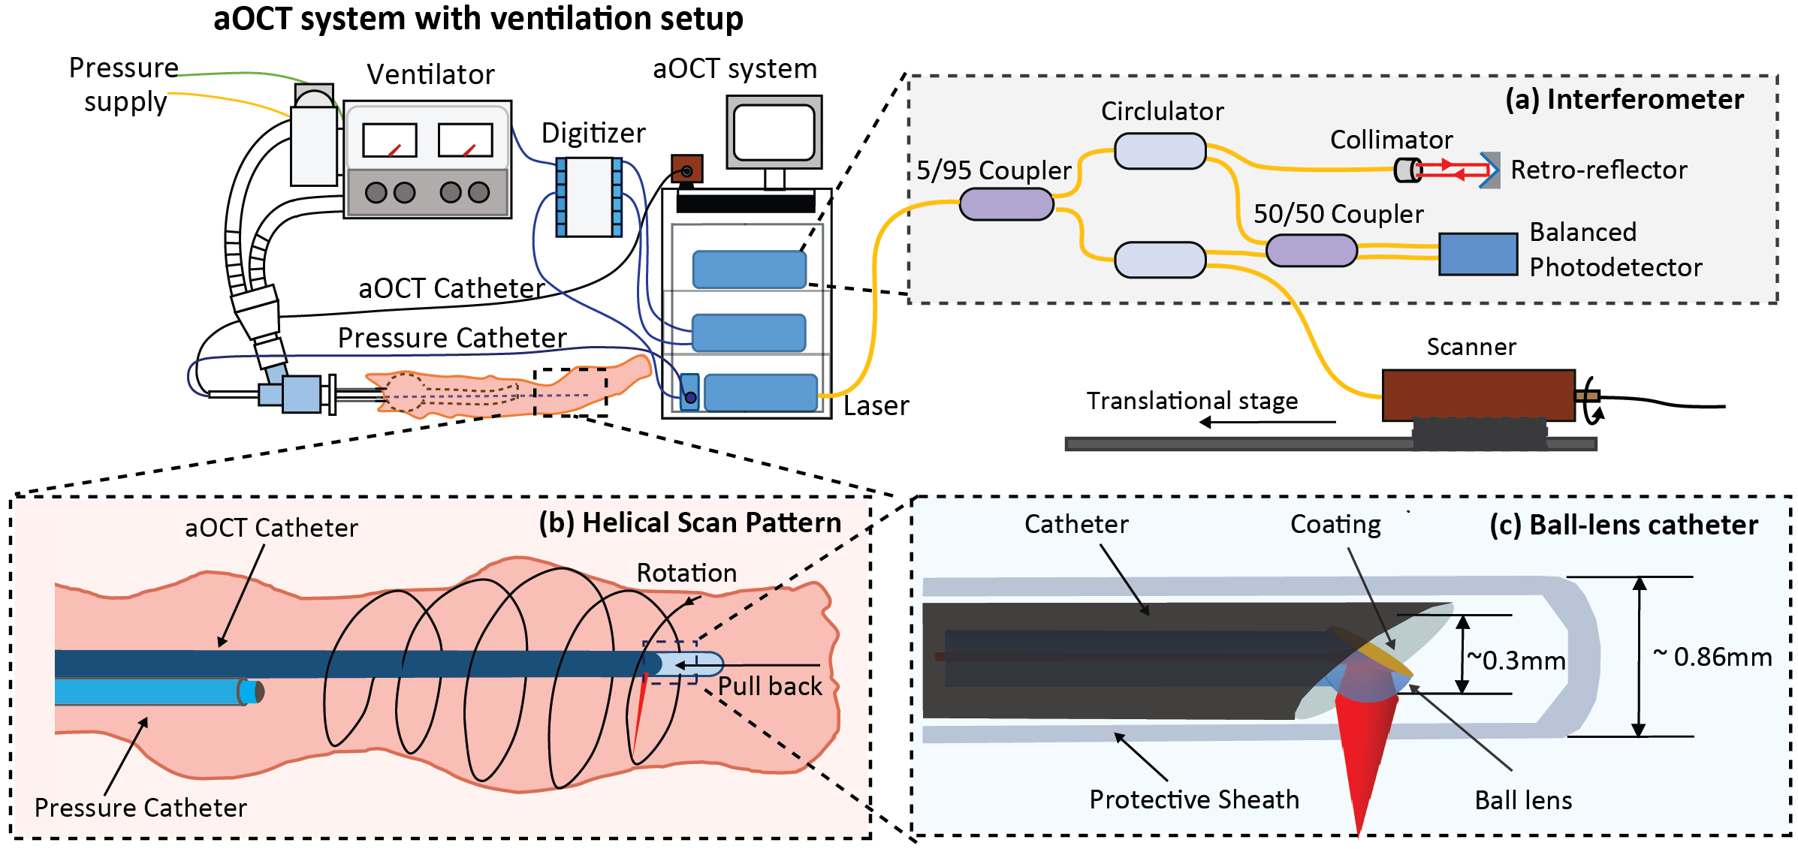
aOCT scan setup
Ventilator
Pressure catheter
Dynamic pressure, elastography

Slide 7
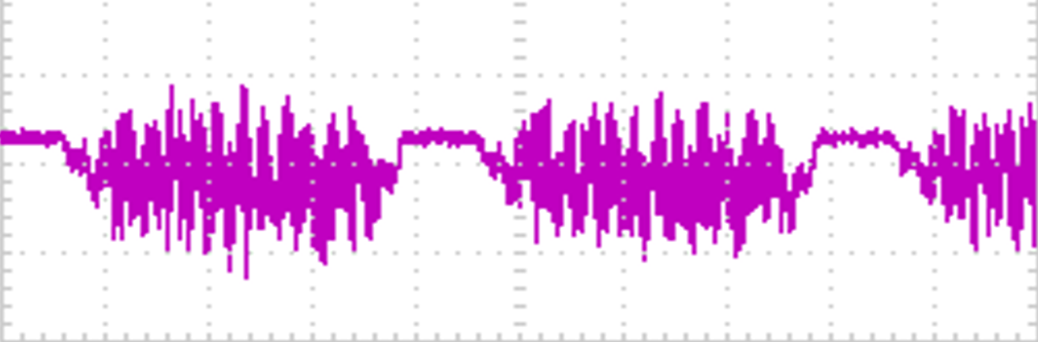
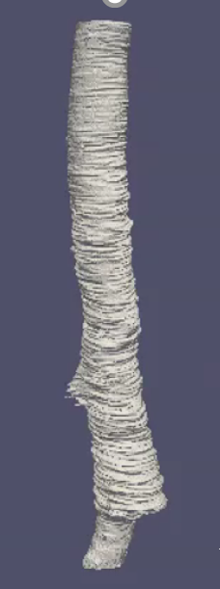
aOCT image acquisition
Modulation signal
aOCT Polar Image
3D reconstruction
Segmentation & resampling
Fourier Transform
A-line
M-Mode
One Rotation
Amplitude
0
z

Slide 8
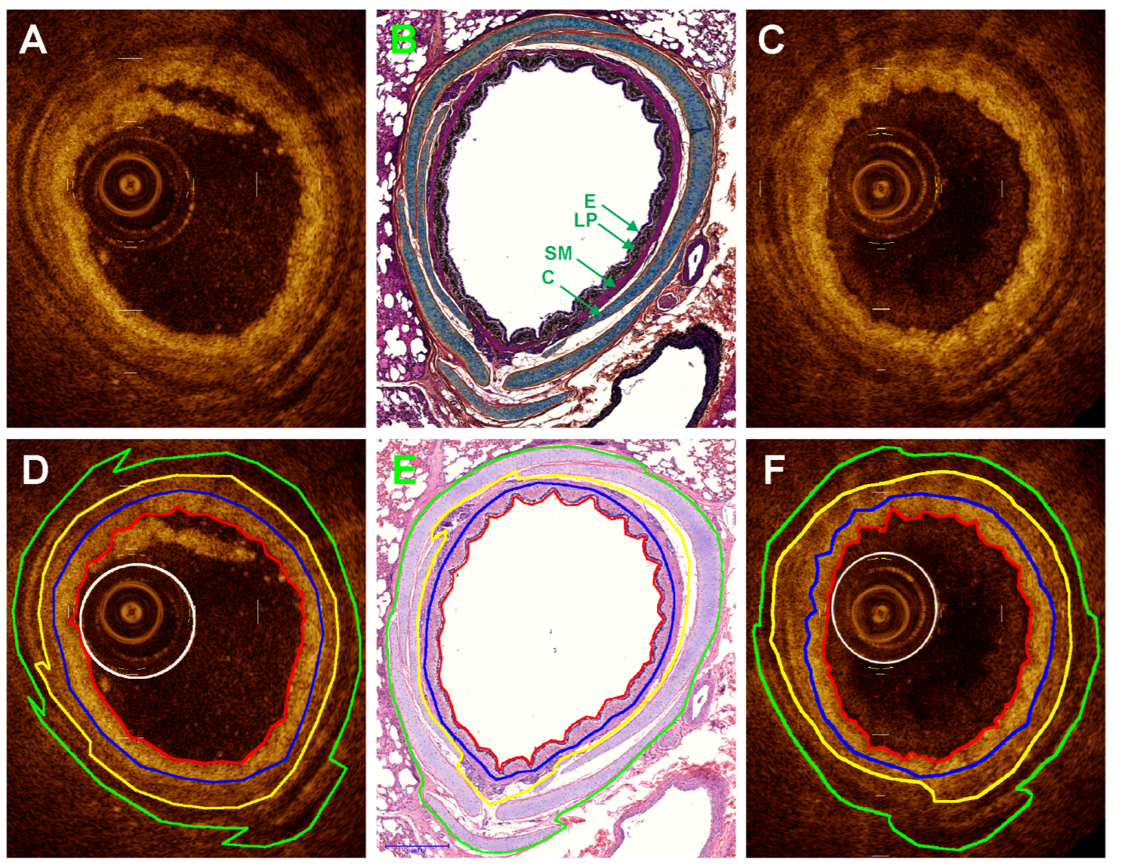
Morphology from other group
OCT and histology images of porcine airway.
A, D) Fresh OCT images,
B, E) H&E and Movat’s pentachrome
photomicrographs respectively,
C, F) Post-formalin fixed OCT images.
E = epithelium, LP = lamina propria,
SM = smooth muscle, C = cartilage.
Lee et al, PLoS ONE 9(6): (2014)
OCT morphology for pig airway has been validated, but at limited imaging range (secondary or tertiary bronchi, airway size ~2-3mm)
Our aOCT imaging allows morphology at a larger imaging range under dynamic pressure.

Slide 9
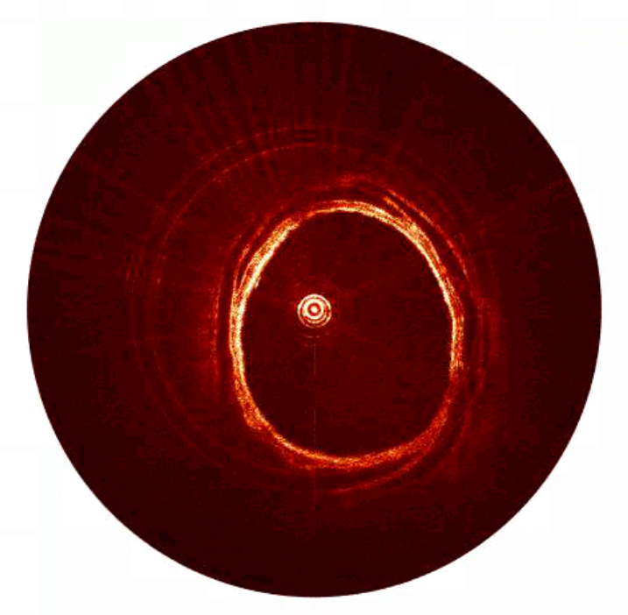
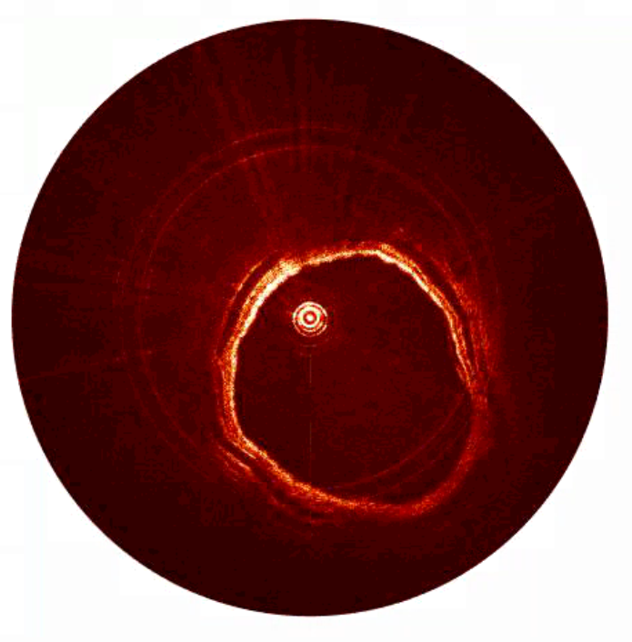
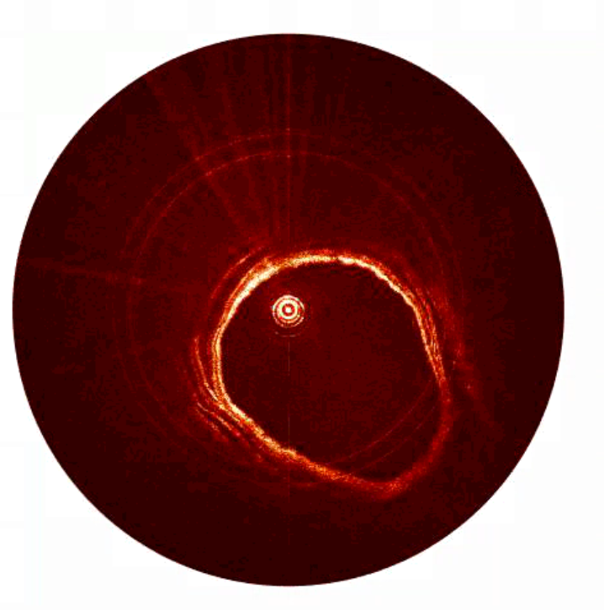
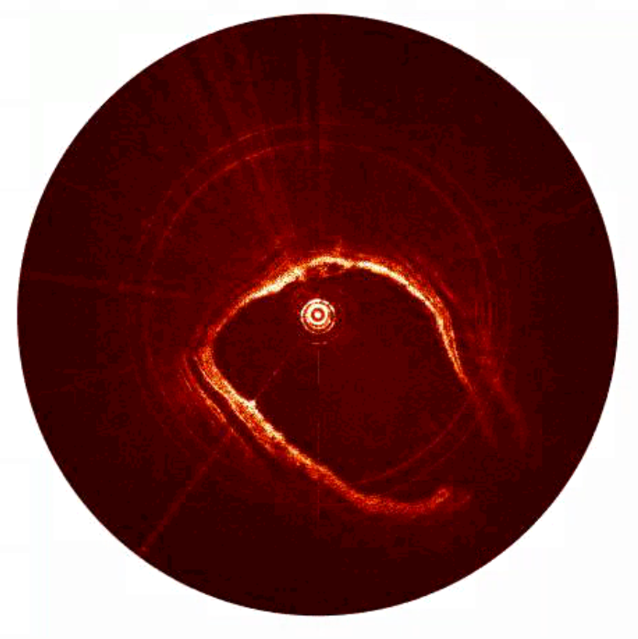
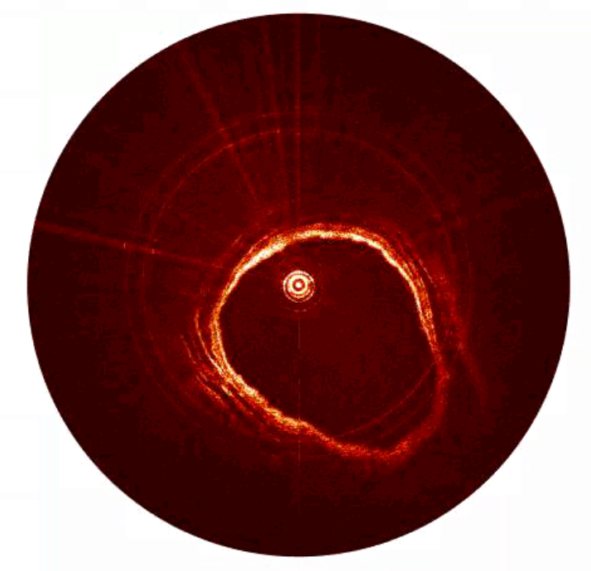
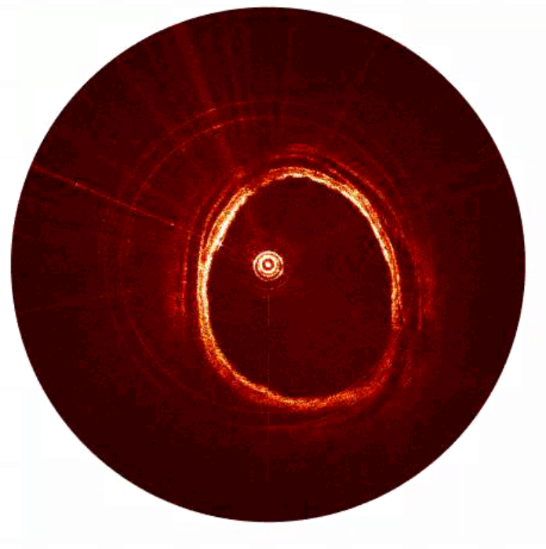
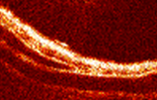
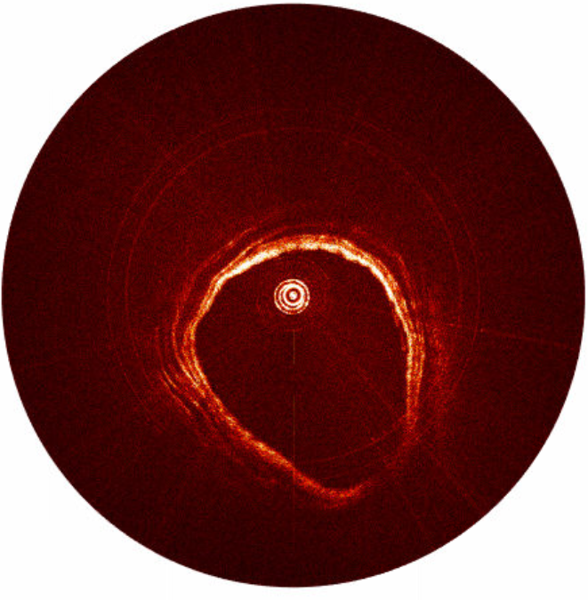
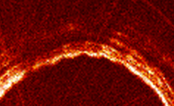
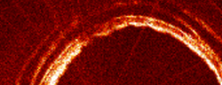
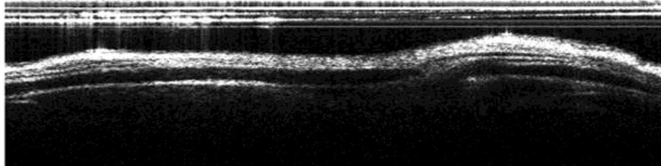
Morphology—Porcine Main Bronchus
(a) Bronchus deformation in one respiratory cycle. Scale bar: 5mm.
2nd bronchi
(b) E = epithelium, LP = lamina propria, SM = smooth muscle, C = cartilage. Zoom in scale bar: 2mm.
Mucosal folds can be seen in the first image with epithelium
LP
C
SM
Hyaline Cartilage
E
Epithelium
Smooth muscle
5mm

Slide 10
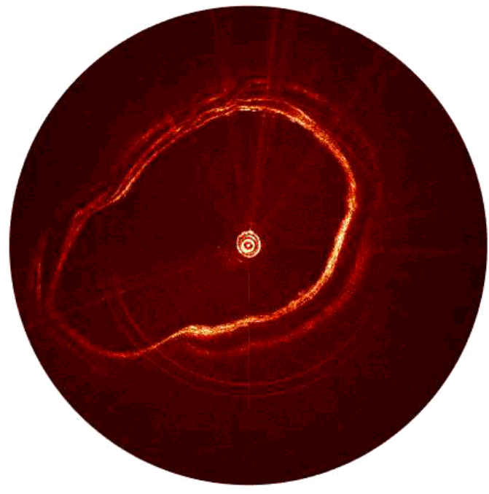
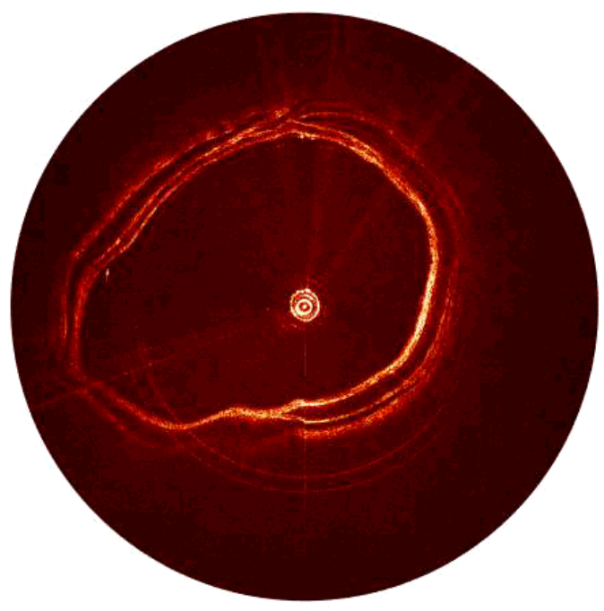
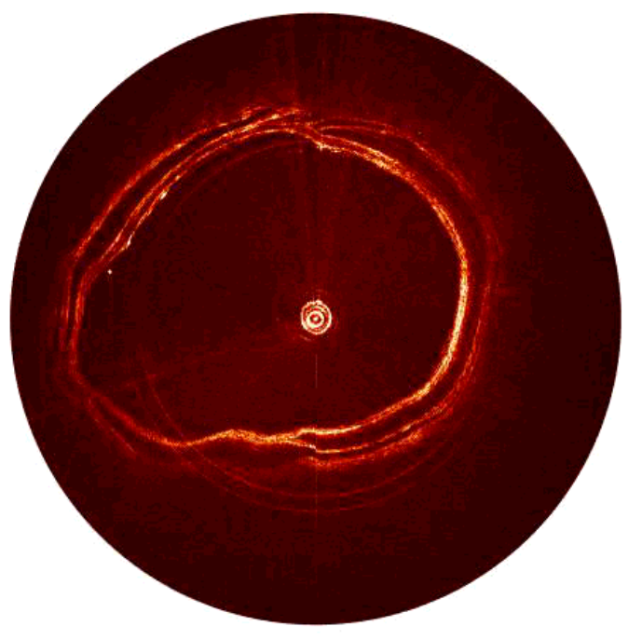
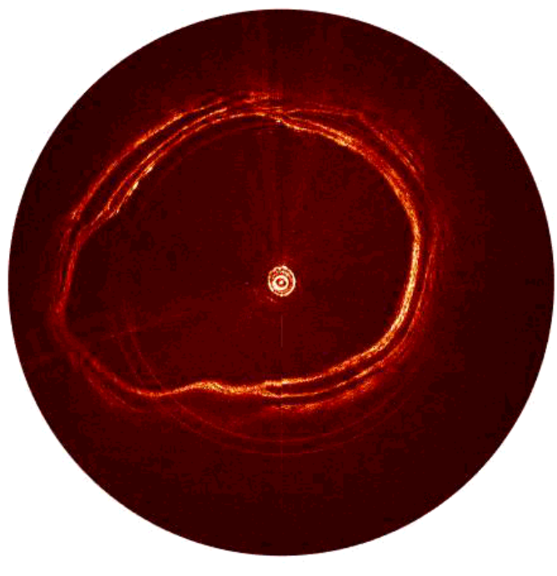
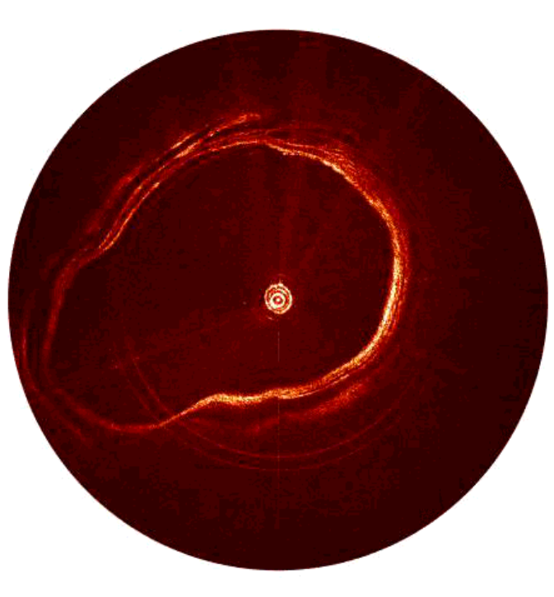
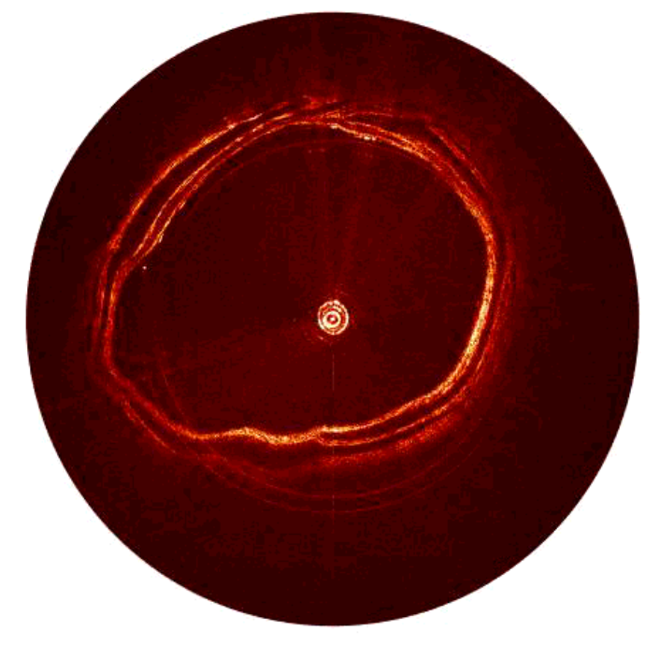
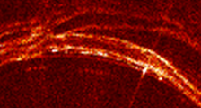
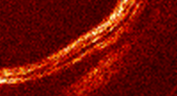
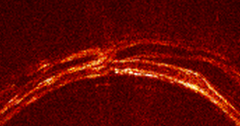
Morphology—Porcine trachea
(a) Trachea deformation in one respiratory cycle. Scale bar: 5mm.
5mm
Hyaline Cartilage
(b) Trachea deformation in one respiratory cycle. Zoom in scale bar: 2mm.
LP
SM
C
Epithelium
E
Smooth Muscle
5mm

Slide 11
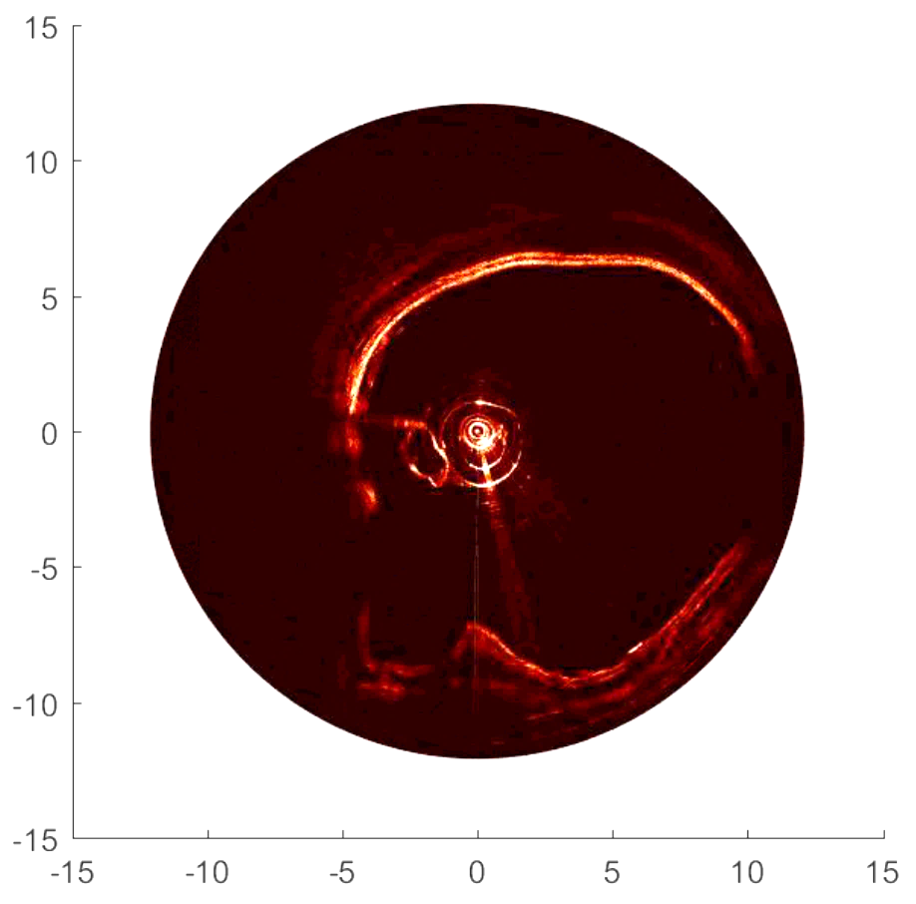
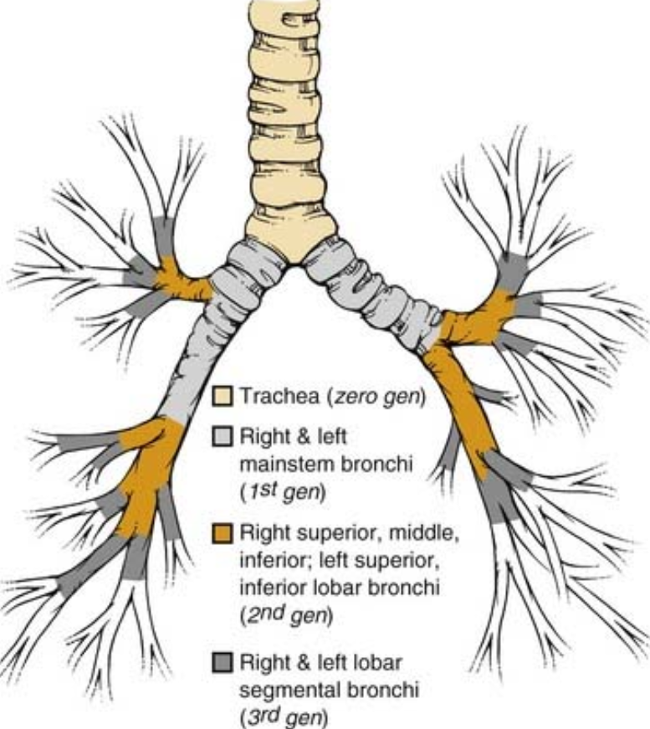
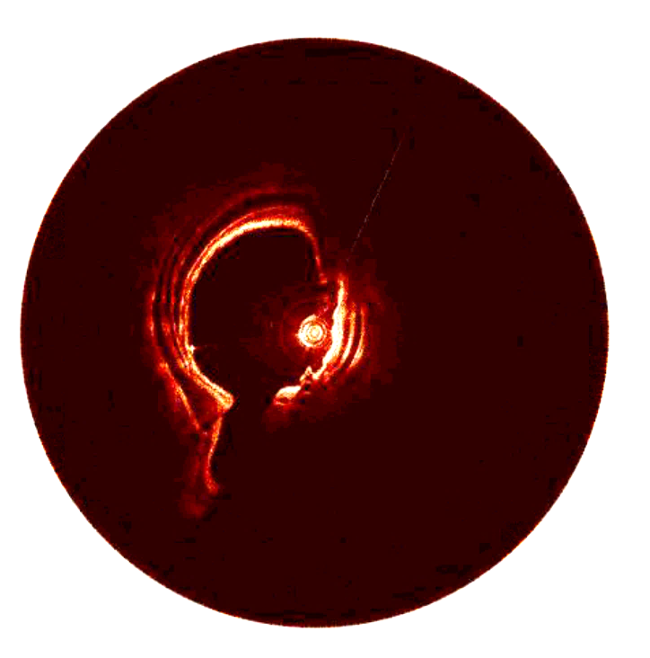
Long-distance PB scan
Trachea
Protective sheath
Pressure catheter
Tracheal bronchus
Bronchi
Rex C. Yung, Emily F. Boss, Tracheobronchial Endoscopy, Figure 75-1. Tracheobronchial schema. Gen, generation.
Bronchi

Slide 12
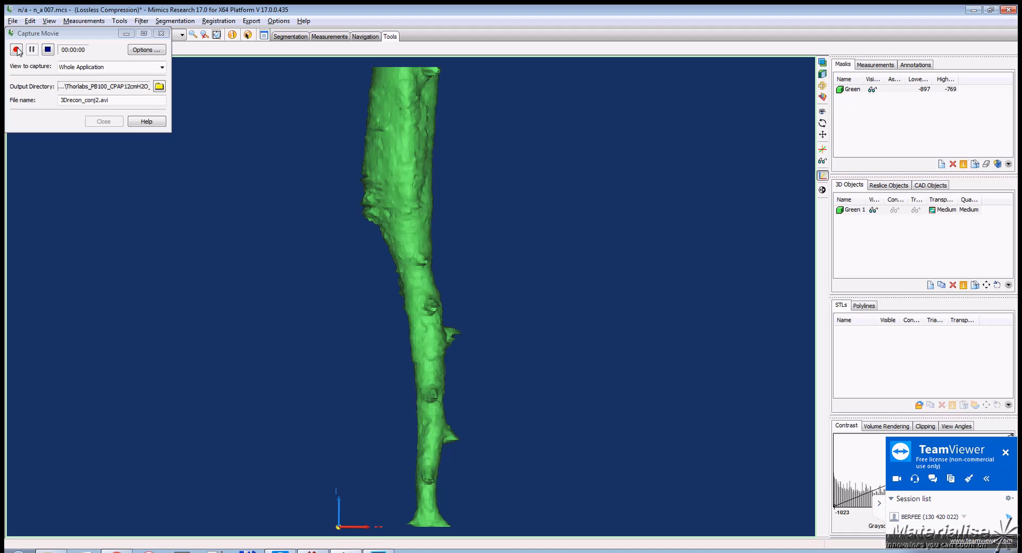
Long-distance PB scan
Tracheal
bronchus
Trachea
Protective sheath
Trachea
Pressure catheter
Tracheal bronchus
Right
main bronchi
100 mm
Bronchi
Bronchi

Slide 13
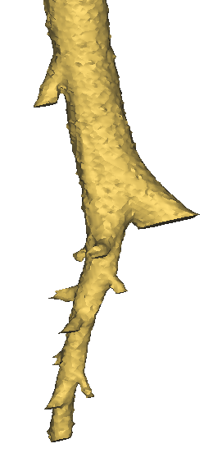
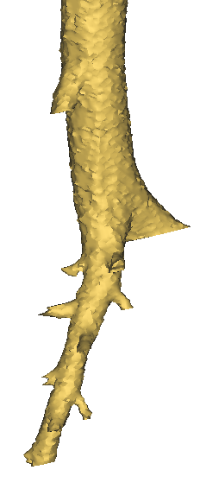
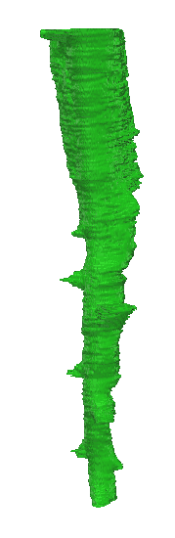
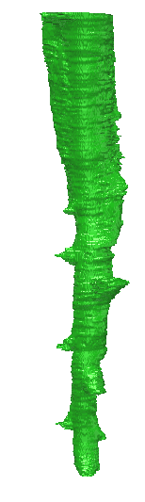
Long-distance PB scan
CT reconstruction
aOCT reconstruction
Tracheal bronchus
Trachea
Bronchus
1
2
3
4
5
Right main bronchi

Slide 14
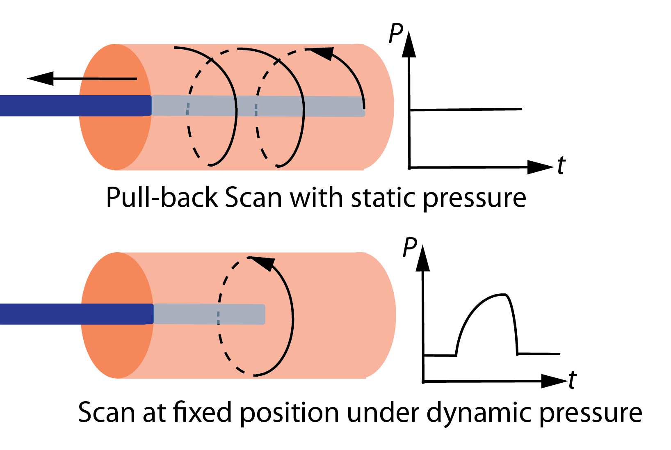
Stationary Scan
Paralysis/ Anesthesia | Paralysis
Bronchoscope | No
aOCT catheter | Yes
Pressure catheter | Yes
Ventilation | Pressure Controlled Ventilation (PCV)
CT mode | Cine
aOCT mode | Stationary

Slide 15
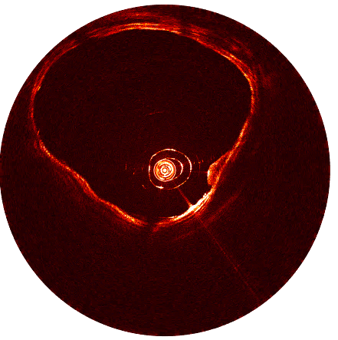
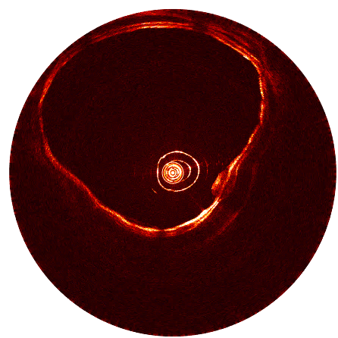
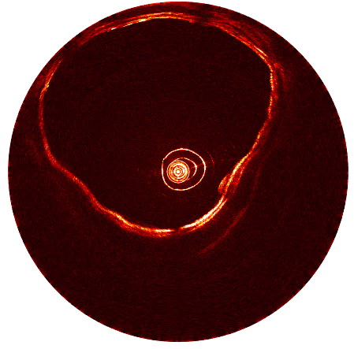
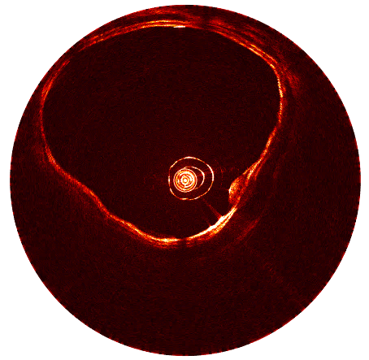
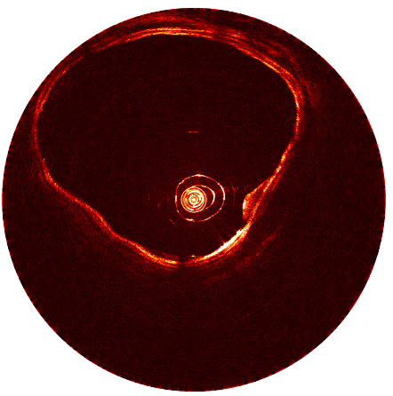
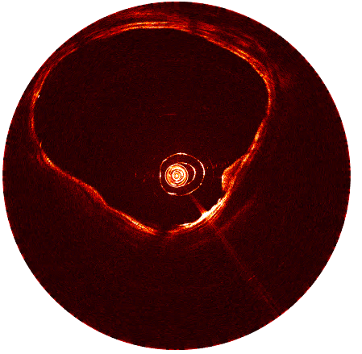
Stationary Scan
aOCT 2D slice of pig trachea at 30cmH₂O
5mm
0 0.6s 1.2s 1.8s 2.4s 3.0s
Pressure
aOCT

Slide 16
Stationary Scan
12cmH₂O
6cmH₂O
*There’s a problem with the synchronization between aOCT and pressure data
— CSA — Pressure
18cmH₂O
24cmH₂O
30cmH₂O

Slide 17
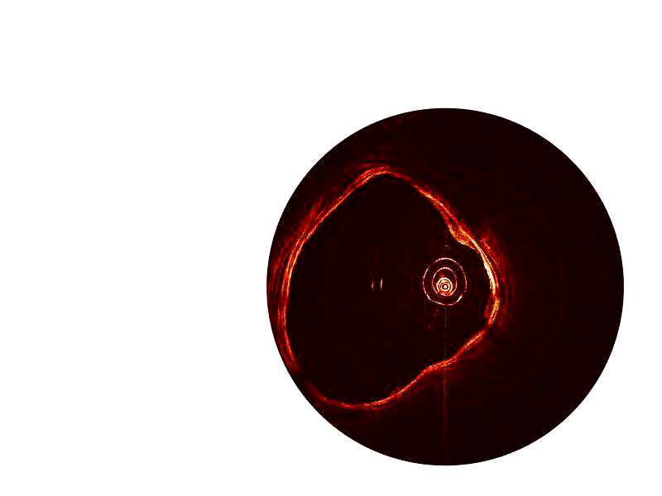
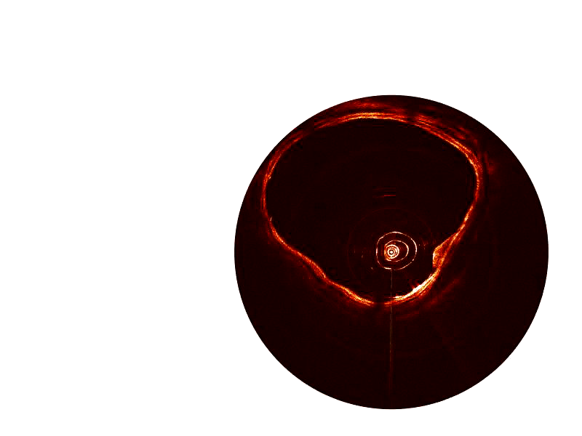
Stationary Scan
6cmH₂O
aOCT video at 12 cmH₂O
5mm
12cmH₂O
aOCT video at 30 cmH₂O
24cmH₂O
5mm
Scan has NURD due to the catheter totally not centered.

Slide 18
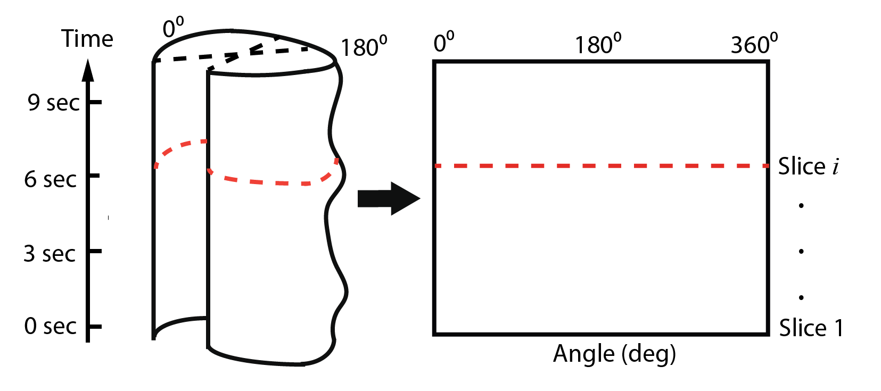
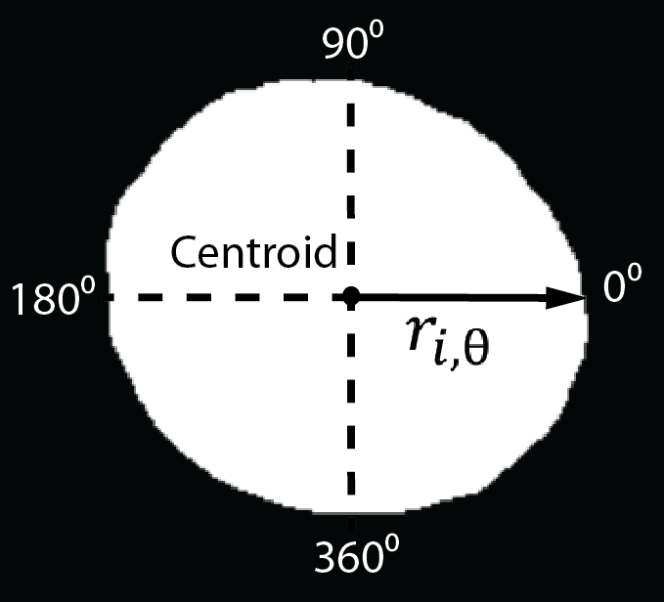
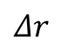
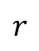
Strain map
$$r$$
Radial strain can be defined as the change in the inner radius ( ) normalized to radius ( ):
$$Δr$$
$$ε_{r}=\frac{Δr}{r}=\frac{r_{i,θ}−r_{j,θ}}{r_{j,θ}}$$
$$r_{i,θ}$$
where, is the distance from the centroid to the trachea wall at slide i (radii based on centroid);
is the radii at slide j with the smallest CSA (zero-strain position).
$$r_{j,θ}$$
Binary segmentation of trachea cross-section at slide i
Strain map

Slide 19
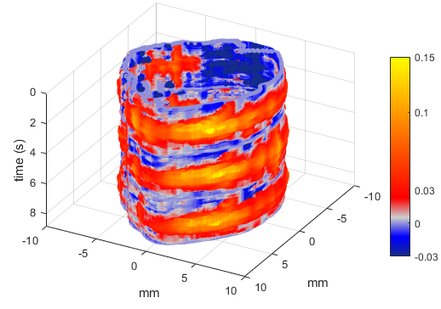
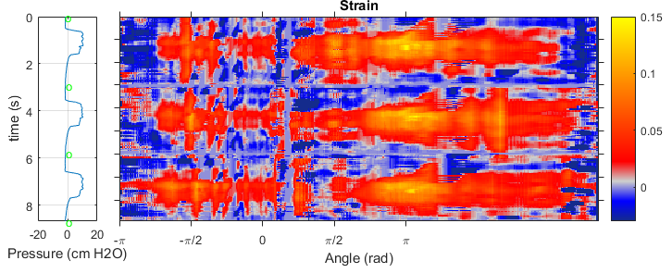
Strain map
MIP = 12cmH₂O

Slide 20


Strain map
MIP = 24cmH₂O

Slide 21


Strain map
MIP = 30cmH₂O (aOCT and pressure not well synchronized)

Slide 22

Trouble shoot
Synchronization problem.
Add time tags to record the exactly time of data collection
Vibration within rotations are observed.
Not by scanner stage vibration
Not by catheter vibration
30cmH₂O
Vibration

Slide 23



Future work
Phantom design -- latex rubber, PVA cryogel, agar/gelatin, agrose
Burn injuries
Tracheas will be scanned before and after:
1) no steam injury (control group, n=3),
2) Moderate injury (n=3, steam exposure time of 30 minutes.
3) severe injury (n=3, exposure time of 60 minutes).

Slide 24
Thank you !

